Slide 1
Electrical
and Electronics science
First year
Computer Science and Engineering
Dr. Shakti Singh
ASSISTANT PROFESSOR
ELECTRCIAL AND INSTRUMENATION
ENGINEERING DEPARTMENT
@shakti.singh@thapar.edu

Slide 2
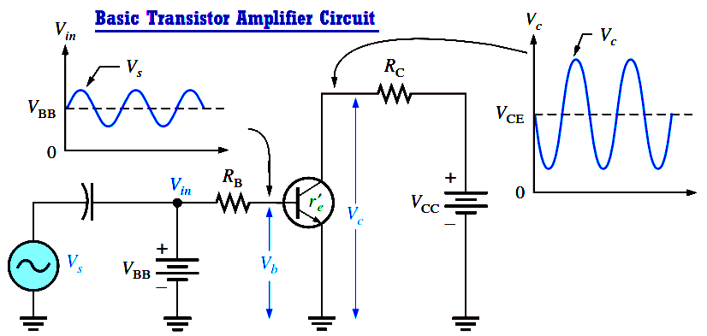
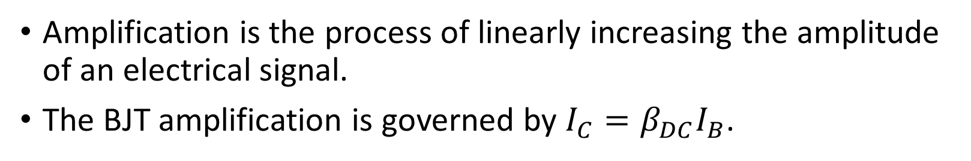
BJT as an Amplifier
Amplification is the process of linearly increasing the amplitude of an electrical signal.
The BJT amplification is governed by $I_{C}=β_{DC}I_{B}$.

Slide 3
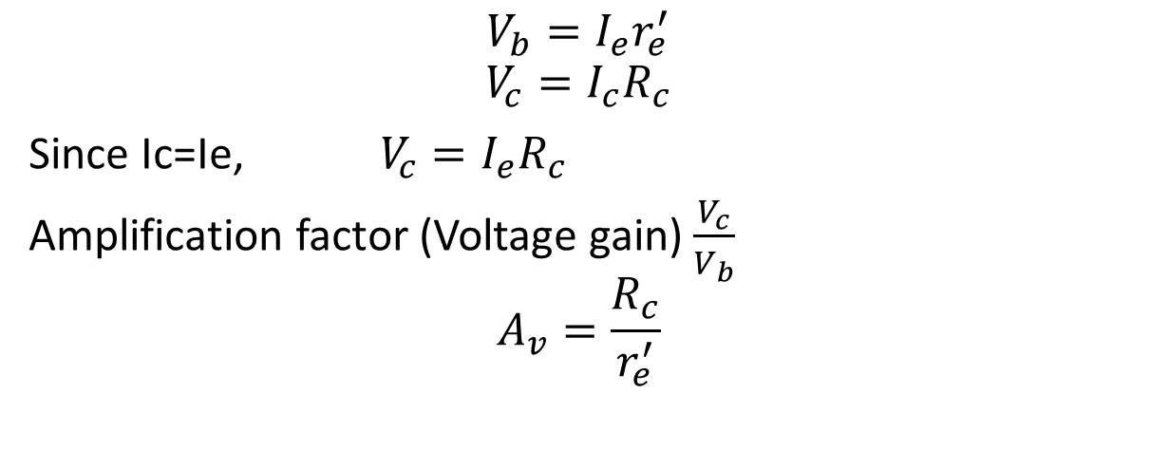
BJT as Amplifier
$$V_{b}=I_{e}r_{e}^{′}$$
$$V_{c}=I_{c}R_{c}$$
Since Ic=Ie,$V_{c}=I_{e}R_{c}$
Amplification factor (Voltage gain) $\frac{V_{c}}{V_{b}}$
$$A_{v}=\frac{R_{c}}{r_{e}^{′}}$$

Slide 4
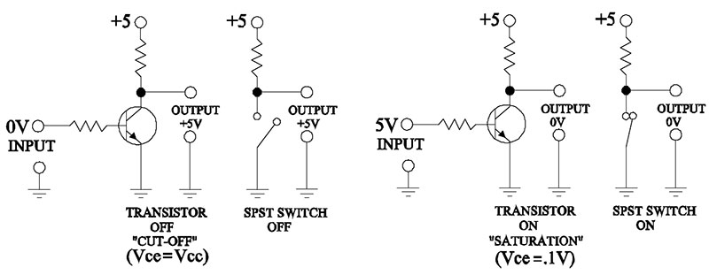
BJT as a Switch
OFF-Cut off mode
ON- Saturation Mode

Slide 5
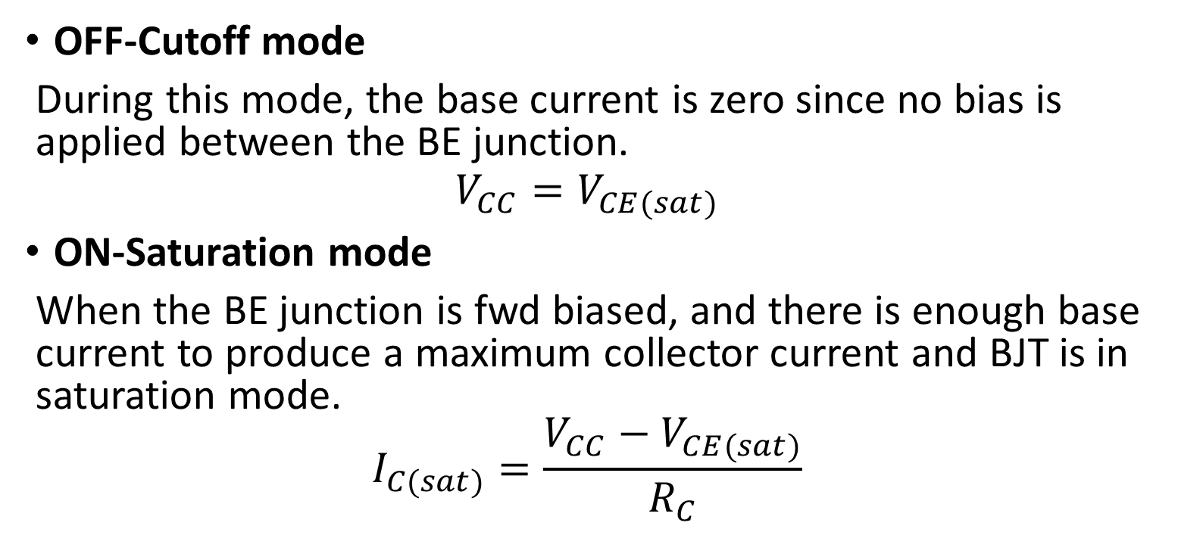
BJT as a Switch
OFF-Cutoff mode
During this mode, the base current is zero since no bias is applied between the BE junction.
$$V_{CC}=V_{CE(sat)}$$
ON-Saturation mode
When the BE junction is fwd biased, and there is enough base current to produce a maximum collector current and BJT is in saturation mode.
$$I_{C(sat)}=\frac{V_{CC}−V_{CE(sat)}}{R_{C}}$$

